Slide 1
NewSQL Database
HUMAIL SHAHZAD -BCSF18M005
ARFA FAROOQI- BCSF18M018
ZAINAB NAZ BUTT-BCSF18M039

Slide 2
INTRODUCTION:
NewSQL is a category of SQL database products that address the performance and scalability issues posed by traditional online transaction processing (OLTP) relational database management systems (RDBMS).
NewSQL databases are the latest technologies to appear in the data management arena to address Big Data problems.
NewSQL databases try to bridge the gap between RDBMS and NoSQL.

Slide 3
HISTORY
The term was first used by 451 Group analyst Matthew Aslett in a 2011 research paper discussing the rise of a new generation of database management systems.
One of the first NewSQL systems was the H-Store parallel database system.

Slide 4
FEATURES
NewSQL system must accommodate the following:
Scale with the level and flexibility of a NoSQL system
Be ACID compliant
Be cost effective and efficient
Not solve the challenge through massive computing needs
Not require middleware either internalized or externalized
SQL as the primary interface
Highly distributed clusters
Key-value or column-oriented data stores

Slide 5
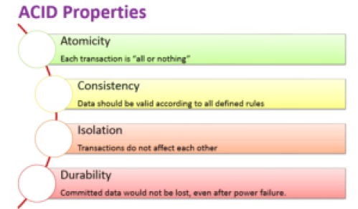
ACID
ACID is an acronym for atomicity, consistency, isolation, and durability. Each of these four qualities is necessary for a transaction to be able to ensure the integrity of data.

Slide 6
ACID cont...
ATOMICITY
Atomicity means that a transaction must exhibit “all or nothing” behavior. Either all of the instructions within the transaction happen, or none of them happen.
Atomicity preserves the “completeness” of the business process.

Slide 7
ACID cont...
CONSISTENCY
Consistency refers to the state of the data both before and after the transaction is executed.A transaction maintains the consistency of the state of the data. In other words, after a transaction is run, all data in the database is “correct.”
ISOLATION
Isolation means that transactions can run at the same time. Any transactions running in parallel have the illusion that there is no concurrency. In other words, it appears that the system is running only a single transaction at a time.

Slide 8
ACID cont...
To achieve isolation, a locking mechanism is required.
DURABILITY
Durability refers to the impact of an outage or failure on a running transaction. A durable transaction will not impact the state of data if the transaction ends abnormally. The data will survive any failures.

Slide 9
FLAVOURS OF NewSQL DB
FIRST FLAVOUR
The first flavor simply provides an automated data sharding layer on top of multiple independent instances of monolithic SQL databases.
SECOND FLAVOUR
The second flavor includes the likes of NuoDB, VoltDB and Clustrix that built new distributed storage engines with the goal of keeping the single logical SQL database concept intact.

Slide 10
CATEGORIES OF NewSQL DB
NewSQL systems can be loosely grouped into three categories:
New architectures
SQL engines
Transparent sharding

Slide 11
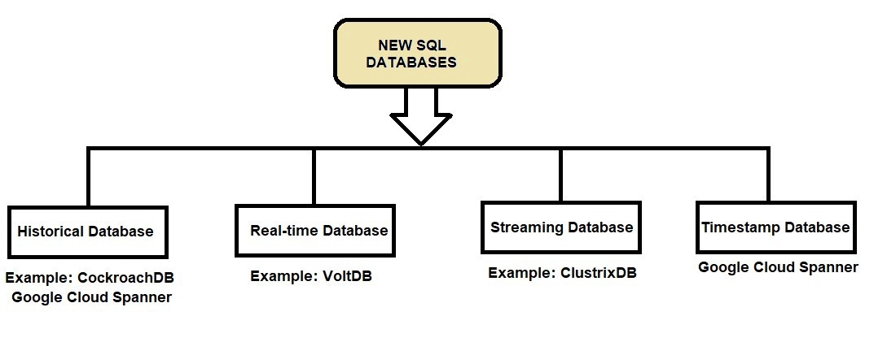
TYPES OF NewSQL DB

Slide 12
TYPES CONT...
Following are a few of the leading NewSQL databases.
TiDB
CockroachDB
FaunaDB
Vitess

Slide 13
TYPES CONT...
TIDB
TiDB is an open source database that supports distributed HTAP (Hybrid Transactional and Analytical Processing) and is compatible with MySQL.
FEATURES
Hybrid
Cloud Native
MySQL Compatible
Less ETL

Slide 14
TYPES CONT...
COCKROACH DB
CockroachDB is a distributed SQL open source database built on a transactional and strongly-consistent key-value store.
It scales horizontally; survives disk, machine, rack, and even datacenter failures with minimal disruption and manual intervention; supports strongly-consistent ACID transactions; and provides a familiar SQL API for structuring, manipulating, and querying data.

Slide 15
TYPES CONT...
FEATURES
SQL Compatible
SQL Compatible
Online Schema Changes

Slide 16
TYPES CONT...
FAUNA DB
“FaunaDB is a modern distributed operational database for cloud and container-centric environments. It is the world’s first commercial database that is inspired by Calvin, a strictly serializable transaction protocol for multi-region environments.”

Slide 17
TYPES CONT...
FEATURES
Active-Active
Multiple Models
Data Temporality
Horizontal Scalability

Slide 18
TYPES CONT...
VITESS
Vitess is an open source database clustering system for horizontal scaling of MySQL through generalized sharding.
Vitess was born out of YouTube’s scaling needs and currently supports its backend.

Slide 19
TYPES CONT...
FEATURES
Scalable MySQL
Topology Service

Slide 20
APPLICATIONS OF NewSQL DB
Typical applications are characterized by heavy OLTP transaction volumes. OLTP transactions;
are short-lived (i.e., no user stalls)
touch small amounts of data per transaction
use indexed lookups (no table scans)
have a small number of forms (a small number of queries with different arguments).

Slide 21
DIFFERANCE BETWEEN NoSQL & NewSQL
NoSQL | NewSQL
New breed of non-relational database products | New breed of relationaldatabase product
Rejections of fixed table schema and join operations | Retain SQL and ACID
Designed to meet scalability requirements of distributed architectures | Designed to meet scalability requirements of distributed architectures
And/or schema-less datamanagement requirements. | Or improve performance sohorizontal scalability is nolonger a necessity.

Slide 22
DISADVANTAGES OF NewSQL DB
Principally, the disadvantages that have been discovered center around NewSQL’s heavy use of in-memory storage.
Critics point to the fact that this can jeopardize the “durability” component of ACID.

Slide 23
The Future of NewSQL
Just like how NoSQL gained momentum earlier in the internet era, the NewSQL databases are gaining momentum and have a lot of potential in the public cloud era.

